Slide 1
Optimization by Simulated Annealing
Jon Raunkjær Søndergaard
Bjørn Hübschmann Mølvig
Mads Ehrhorn Kjær

Slide 2
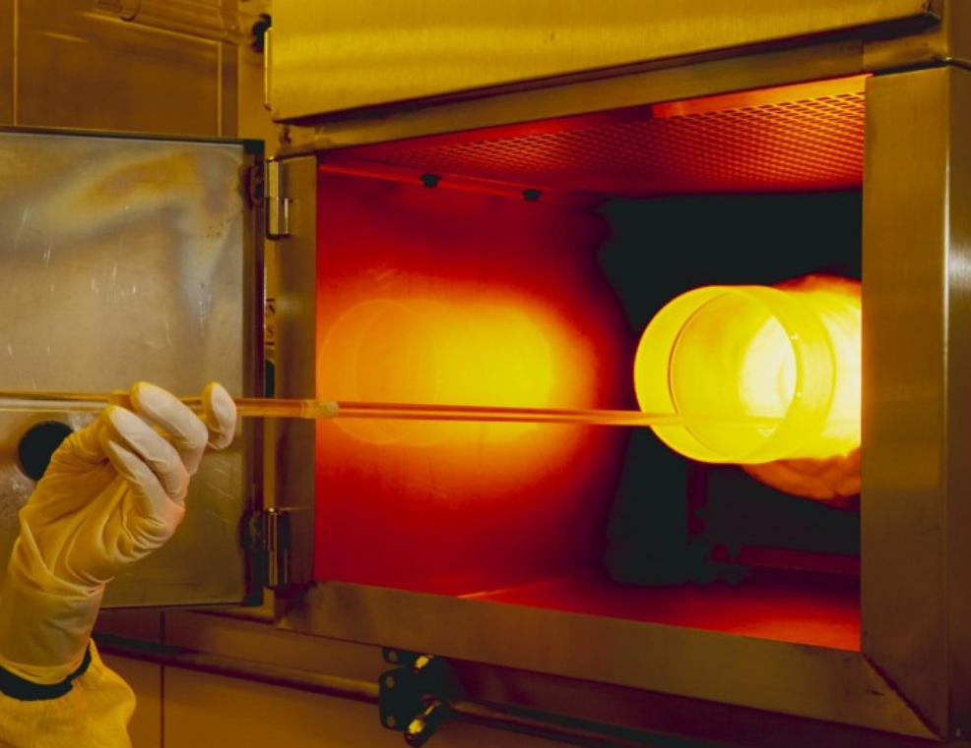
Inspiration – Annealing and Statistical mechanics
Slowly decreasing temperature
→ Stronger alloy
Minimize a cost function by slowly reducing the ‘temperature’
Proposed in “Optimization by Simulated Annealing”, 1983
Annealing
http://www.turingfinance.com/simulated-annealing-for-portfolio-optimization/

Slide 3
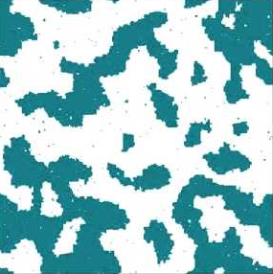
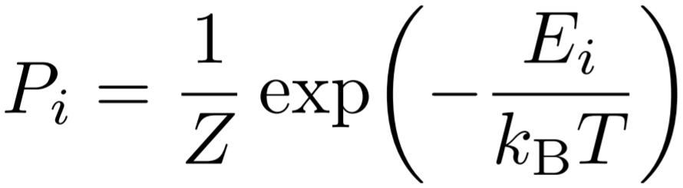
Statistical Mechanics
Anti-aligned spins → higher energy
Probability of finding system in certain state is proportional to its Boltzmann factor
Magnetization in a metal
https://www.youtube.com/watch?v=PWUTBnvGegg

Slide 4

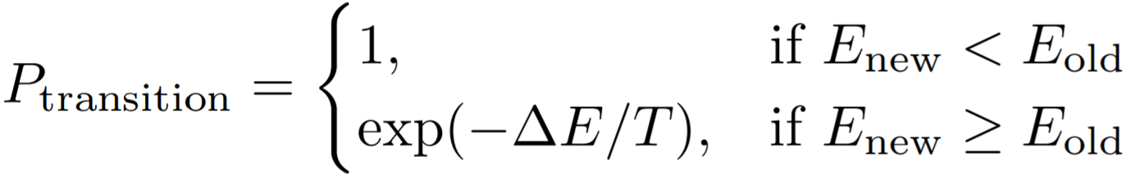
The Algorithm
Define cost and temperature functions E and T
Propose a candidate change to system
Accept change with probability
Lower temperature and repeat
From: https://en.wikipedia.org/wiki/Simulated_annealing

Slide 5
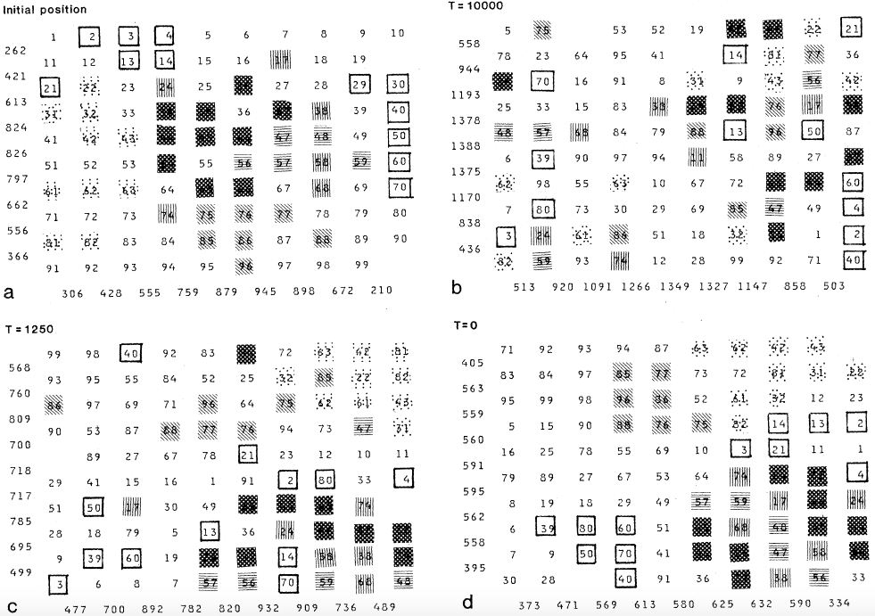
Applications
Placement of chips on module Minimize signal propagation time without creating too congested regions Swapping two chips Constraints on distance for low temperatures
From: Optimization by Simulated Annealing, S. Kirkpatrick, C. D. Gelatt, M. P. Vecchi

Slide 6
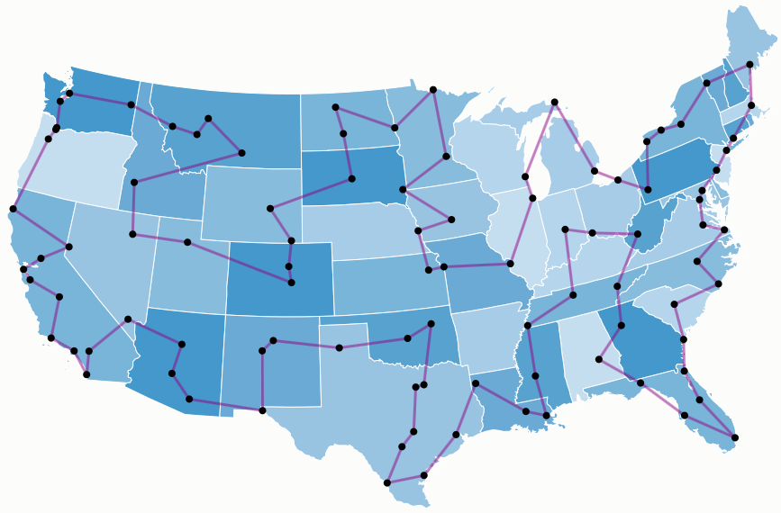
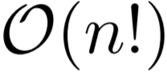
Travelling Salesman
Given a list of cities, what is the shortest route that visits each city once before returning home? Brute force solution has time complexity
From: http://examples.gurobi.com/traveling-salesman-problem/

Slide 7
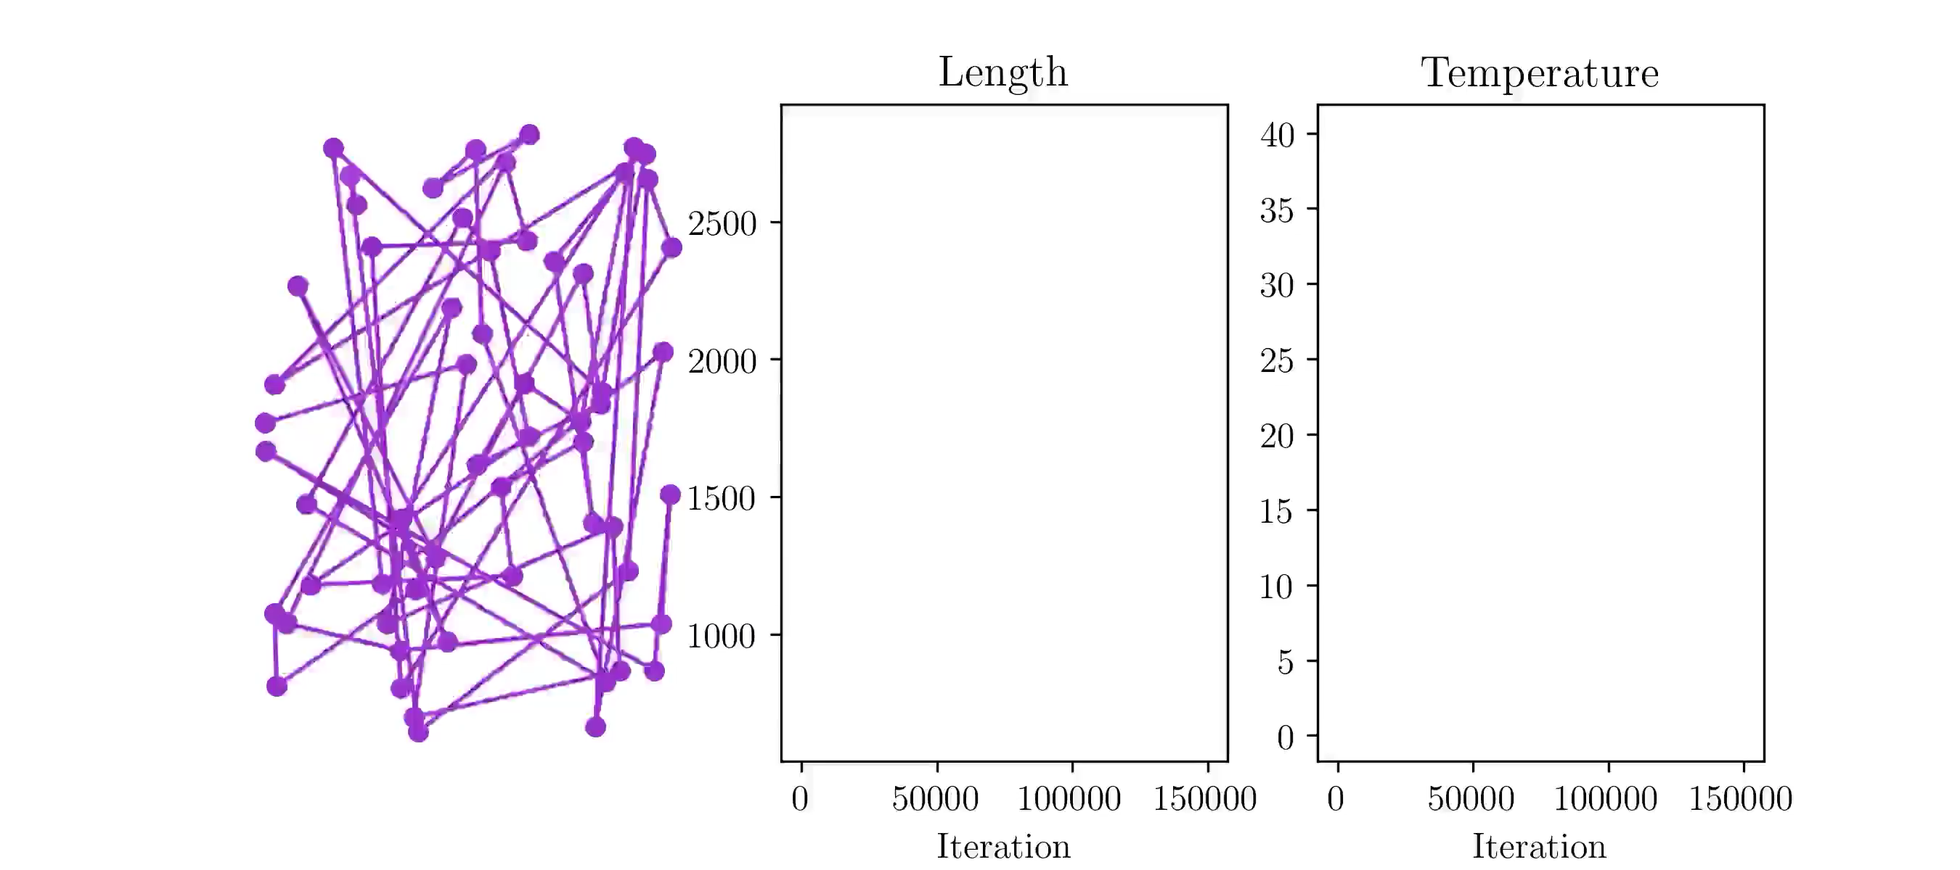
Travelling Salesman

Slide 8
Travelling Salesman
Initial random route 60 cities randomly distributed 2500 temperatures 60 swaps at each temperature Near optimal final route

